Slide 1
St. Stephen’s Trip to Spain – May 2023

Slide 2
Why go to Spain?
To truly understand the purpose of language learning.
A chance to put into practice their in-class language learning.
To communicate with native Spanish speakers in real life situations.
To experience full emersion in the target language.
To explore and reflect upon the culture and customs of another country.
To develop team-building skills and to bond as a class.

Slide 3
Where? ……. Location
El Puerto de Santa María, Cadiz in southern Spain
A small beach town with little foreign tourism
Spark Spanish Residence on a quiet, residencial street

Slide 4
When? Departure Dates- 2 separate Y6 classes to travel to Spain
First class: Monday 15th May 2023- Friday 19th May 2023
Second class: Monday 22nd May 2023- Friday 26th May 2023
Travel to the airport by private coach
Arrive at airport by lunchtime

Slide 5
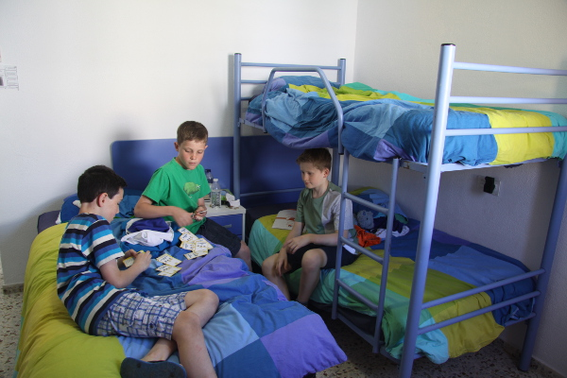
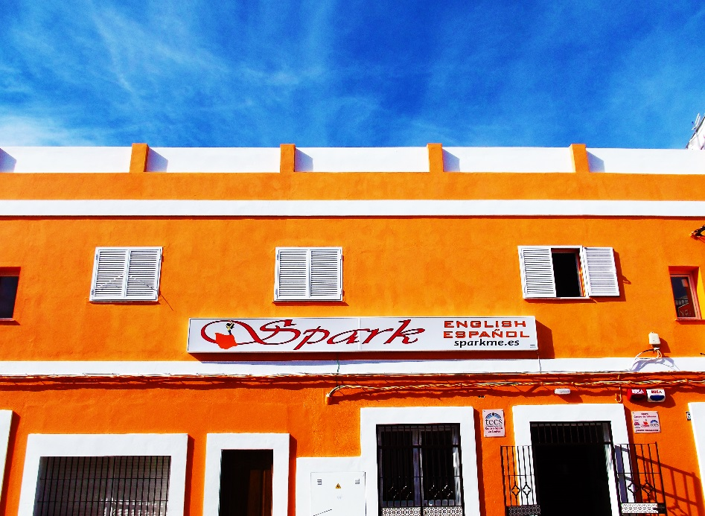
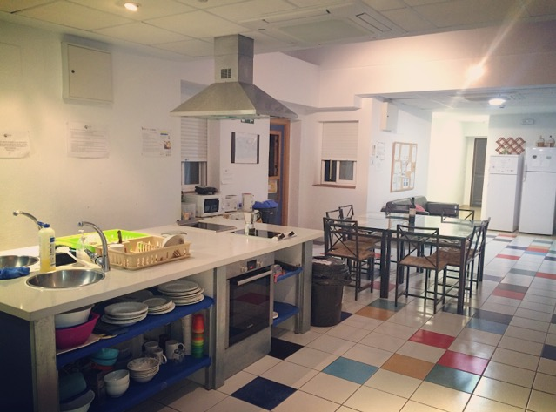
Spark Residence Bedrooms and Kitchen
13 rooms on the first floor
2 – 6 students per room
All rooms en suite
Kitchen facilities
Exclusive usage for St. Stephen’s students and teachers

Slide 6
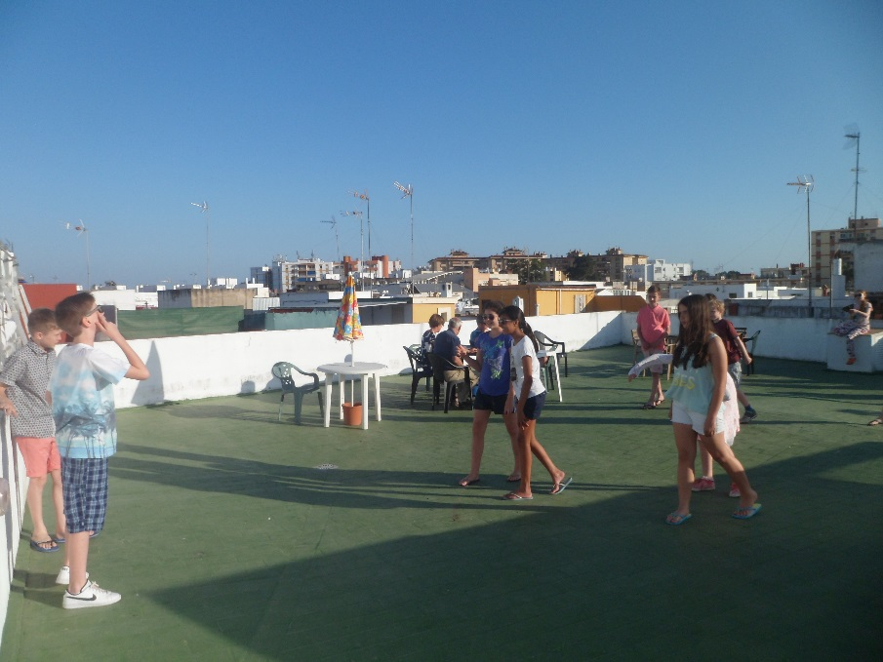
Spark Residence Roof Top Terrace
Huge roof terrace
Eating area covered from sun, rain and wind
BBQ, some activities and most meal times spent here
Outdoor film screening

Slide 7
Food
Toast and cereal for breakfast
Rolls / sandwiches, crisps, fruit and water for lunch
Main meal for dinner (BBQ, Spanish omelette, vegetable and pasta dishes, paella and tapas) followed by dessert

Slide 8
Itinerary/Activities (order of activities may change for 2023)
 | Morning | Afternoon | Evening
Day 1 | Leave from school early and fly to Spain. Lunch at an Andalusian town TBC | Pick up from airport and transfer to Spark school, Puerto Santa Maria (near Cadíz)- Settle into rooms | Beach & Rooftop BBQ dinner
Day 2 | Spanish language class. Tour of El Puerto, cathedral and Moorish castle | Visit the town market to buy ingredients for paella (in Spanish!) | Paella and Beach & Flamenco lesson
Day 3 | Spanish language class. Ferry to Cadíz & Churros con chocolate at a local cafe | Visit Torre Tavira camera obscura and picnic in Parque Genoves | Beach & Rooftop dinner and film
Day 4 | Spanish language class. Sports day: learn to play padel | Time on the beach/ final shopping | Rooftop dinner & Spark slideshow presentation
Day 5 | Packing/ transfer to airport | Lunch at the airport | Pick up from school

Slide 9
Day of travel…
Private coach transfer with chaperone to take the group onwards from Sevilla airport
Picnic lunch in an Andalusian town/city TBC
Settling in at Spark school, El Puerto by late afternoon

Slide 10
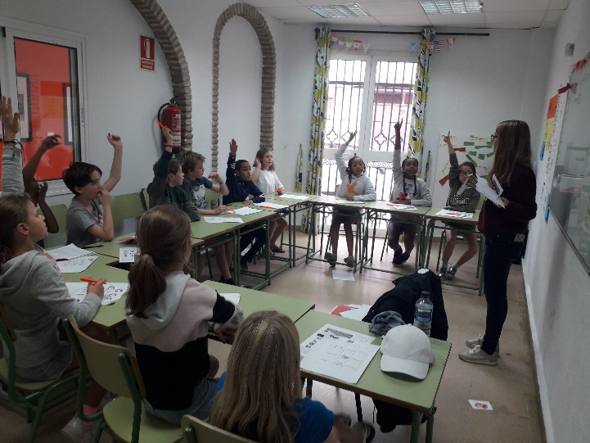
Daily Spanish Classes
Children taught in small groups (maximum of 10 students per group)
Native qualified Spanish teachers
Focus on coversational / practical language such as food, trips, prices
Postcard writing in Spanish
Children to take their lessons outdoors in the afternoons completing vocabulary scavenger hunts, buying vegetables at the market etc.

Slide 11
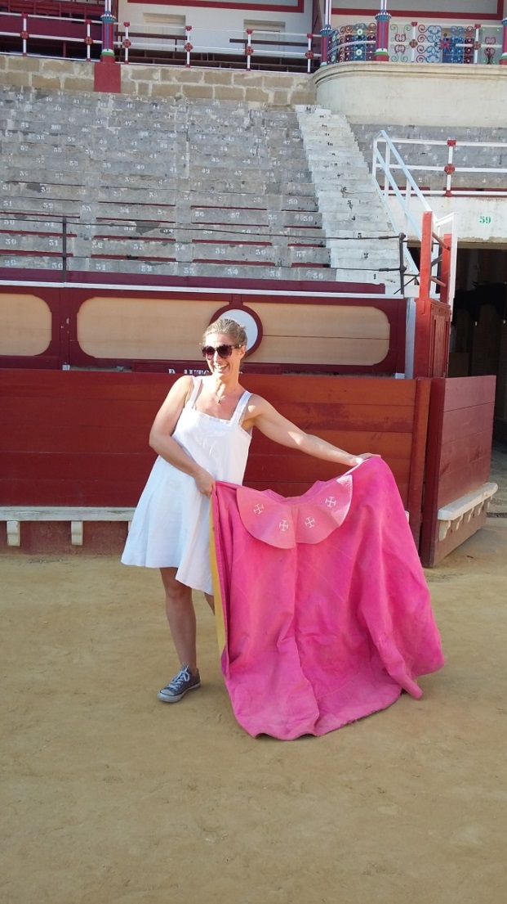
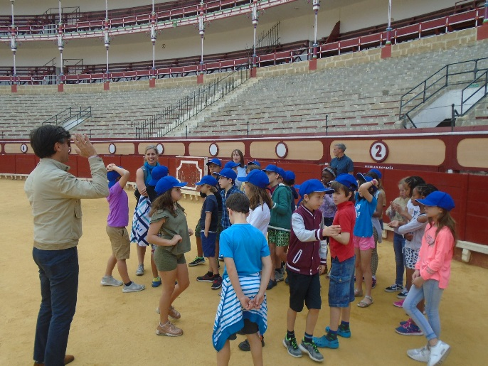
Tour of El Puerto
Bullring tour?
Castillo San Marcos tour
Market trip
Visit the local cathedral
Beach outing (paddling only-weather dependent)

Slide 12
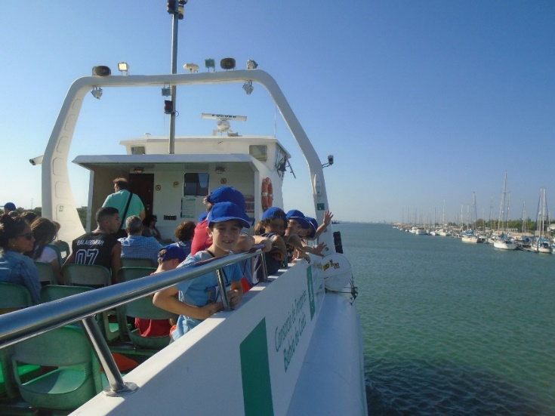
Cádiz Outing
Return ferry trip
Churros con chocolate tasting at an authentic café
Torre Tavira (camera obscura) visit
Picnic lunch at the Parque Genovés

Slide 13
Shopping for ingredients at the market and cooking paella for supper…..

Slide 14
Flamenco dancing…

Slide 15
Cost of the trip…..£400 in 3 instalments… (deadline for 1st instalemnt-15th September if you wish for your child to go)
Due now
November
January
£150
£150
£100

Slide 16
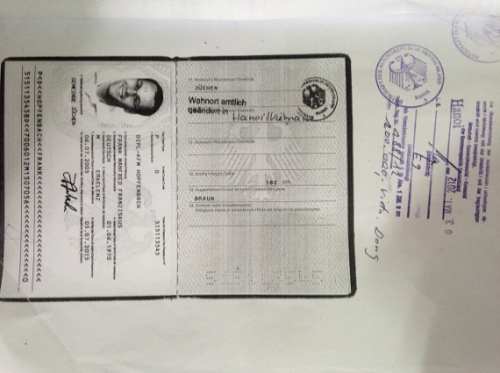
What next……
GHIC card
First instalment (£150) is due no later than Friday 16th September
Hand in a photocopy of your child’s passport to secure your child’s place on the trip.
If your child’s passport expires by April 2023 apply for a new one now. There were long delays processing passports for the last group.
Check if you have a GHIC card for your child and if not apply for one now

